Slide 1
A public health approach for deciding policy on infant feeding and mother–infant contact in the context of COVID-19
By: Camylle Arsenault, Viola Wu, Steven Huang, and Yizhe Zhang
https://www.thelancet.com/journals/langlo/article/PIIS2214-109X(20)30538-6/fulltext#seccestitle50

Slide 2
Background
COVID-19
A contagious disease
Spread worldwide,leading to an ingoing pandemic
Easily to get infected
Mother breastfeeding and skin-to-skin contact.
WHO recommends
Be beneficial for a newborn
Steven Huang, V00883991
Notes:
Since COVID-19 arose last year, there has been lots of anxiety regarding how it can be transmitted. From newborns to the elderly, nobody is safe from this new virus. The WHO strongly recommends, in the first hour of life, continued breastfeeding and skin-to-skin contact. These two have proven time and time again to be beneficial for a newborn, for what about for a COVID-19 positive mother? Can COVID-19 be transmitted from mother to baby through breastfeeding? This article compiles data comparing the deaths of babies breastfed by their COVID-19-positive mother and the deaths of newborns baby lacking this connection.

Slide 3
Summary
There are two comparisons
Compare two death rates of babies in different scenarios
Compare the infected rate of babies with mothers who have the symptoms of SARS or not.
Viola Wu, V0082839
Notes:
•Compare two death rates, breastfed from a COVID-19-positive mother versus not breastfed at all and/or early separation from mother
•Compare asymptomatic and symptomatic mothers and its effects on the newborn
•In order to be able to educate the public, mostly new mothers, on if they should breastfeed their infants if they test positive for COVID-19, or other possible viral agents in the future.
•It could potentially assess the risks by tabulating the effects on child survival, lifelong health, and development.

Slide 4
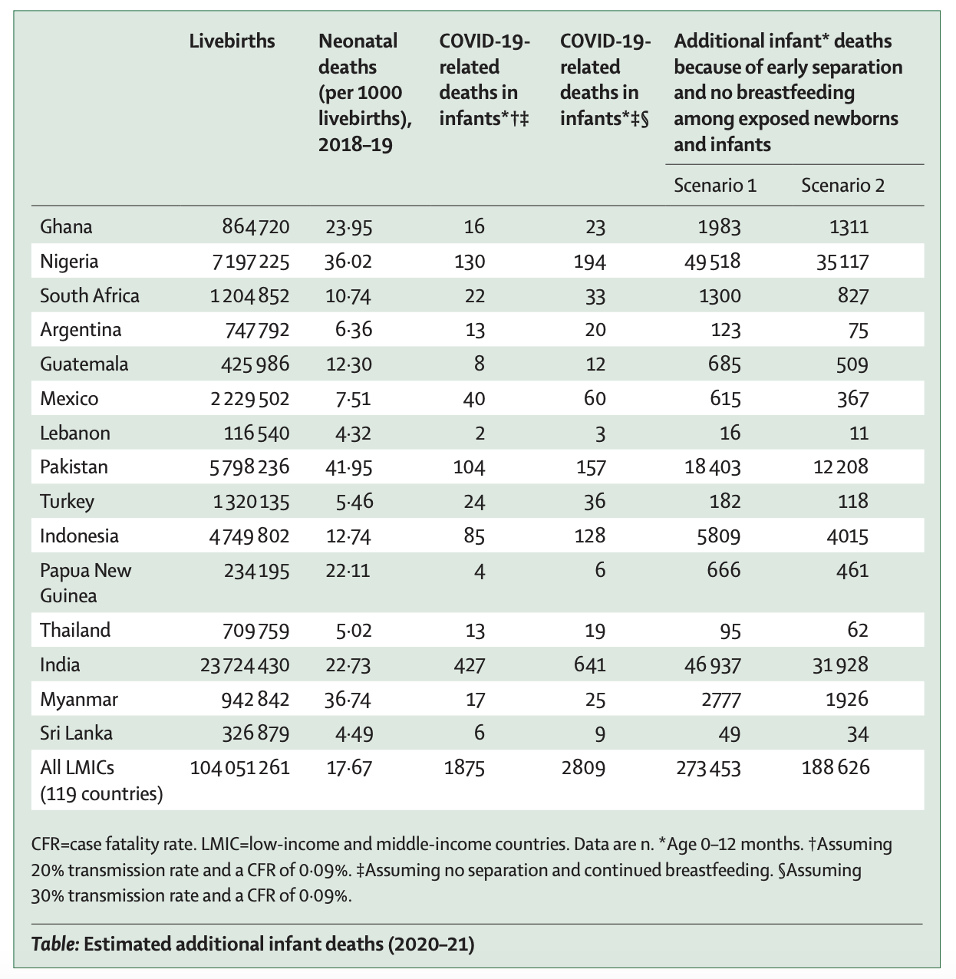
Data and Results
Yizhe Zhang, V00875906
The data table shows that in LMIC infants younger than 12 months:
annual deaths
when transmission probability is assumed to be 20% or 30% , the COVID-19-related deaths
additional infant deaths because of early separation and no breastfeeding
Very low COVID-19-infected infants and children.
Delays and interruptions of breastfeeding effects more.
Notes:
•This table lists a number of low- to middle-income countries, followed by a comparison of COVID-19 related deaths in infants and the deaths related to early separation and/or the lack of breastfeeding.
•Deaths caused by early separation are considerably higher than the ones related to COVID-19, which would prove beneficial to follow the original WHO recommendations regarding newborns.
•Mothers should however follow the general government guidelines to minimize the transmission of COVID-19, such as washing their hands often.
•Since the disease is still new, next to no data is available, which is why these data are estimated by either 20% or 30% COVID-19 related deaths.
•Determined that babies are 67 times more likely to die from lack of breastfeeding or early separation from mother, than of COVID-19.

Slide 5
Methods
Sample size determination
Low- to middle-income countries
Numerical descriptive method
# of live births
Review of 40 studies
Asymptomatic vs symptomatic
Average of 18.8%, with a maximum of 44.6%
20% incidence rate, 30% overestimate
Camylle Arsenault, V00931623
Notes:
Sample size determination
•Compiled a list of low- to middle-income countries
Numerical descriptive method
•Found the number of livebirths in said country
•Review of 40 studies
•Determined that asymptomatic COVID-19 mothers are less likely to transmit the disease to their newborn.
•In the 40 studies, the average transmission rate between mother to newborn is 18.8%, with a maximum of 44.6%.
•This is what formed the assumption of a 20% incidence rate shown in the table, as well as a 30% incidence rate as an overestimate.

Slide 6
Conclusion
The study does recommend following the original WHO recommendations. (Breastfeeding and skin-to-skin contact)
COVID-19-positive mother ( breastfeeding and close-contact) has a drastically lower mortality rate than separation and/or lack of breastfeeding
Steven Huang, V00883991
Notes:
•With a COVID-19-positive mother, breastfeeding and close-contact with a newborn still has a drastically lower mortality rate than separation and/or lack of breastfeeding. Taking the appropriate precautions and following government guidelines, the study does recommend following the original WHO recommendations.

